Slide 1
BUSINESS & PRODUCT STRATEGY

Slide 2

agenda
1 | Our Understanding of Business Ecosystems
2 | Our Approach to Address Key Challenges
3 | Proposed Engagement Timeline
4 | Proposed Key Stakeholders
5 | Success Stories & Use Cases

Slide 3
Our Understanding of BUSINESS ecosystem
Services & Offerings
Business Objectives
Key Challenges
Wholesale & Enterprise
Build A Sustainable Business Model In B2B Space
Grow Through Innovation Of New Solutions And Service Offerings
  How can they build and execute a comprehensive and sustainable business plan to accelerate its growth and market share in Malaysia?
  How can they position and differentiate itself in the B2B market to be able to provide its core services and other niche offerings by utilizing TNB's existing assets and competencies?
  How can they look at both organic and inorganic growths as part of its overall growth strategy moving forward?
  What are the various value-added services which can be offered along with their connectivity services to be able to gain more market share ?
  TNB being a utility leader in Malaysia, how can it help with existing infrastructure to be able to uplift their DC services / or other ICT offerings ?
  Can they build strategic partnerships with players like Maxis, Axiata, DNB or Hyperscalers to be a participant in end-to-end offerings?
  How can they leverage on the Use Cases and Client References as benchmarks in its business plans?
Carrier Circuit
Broadband Infra
Telco Tower Fiberization
IP Transit
SME & Consumer
Leverage Utility Infrastructure & Assets For Connectivity & ICT Business
Strengthen Digital Presence
Residential Connectivity
Business Connectivity
Enterprise Connectivity
  Private Leased Line
  Dedicated Internet Access
Managed Services
Increase Top Line Through New Sales Avenues
Leverage Partnership And Collaboration With Eco-partners
Smart Solutions

Slide 4


OUR APPROACH TO ADDRESS KEY CHALLENGES
Discovery & Scoping
Interviews with the stakeholders to agree the scope of engagement
Agree on workshop methodology
Project communication & mobilization of project team
Project Charter
In-Scope Stakeholder Map
Engagement Plan
Workshop planning & execution
Communication Plan
Governance plan
KPI definition
Assessment
Validate existing GTM strategy
Analyse business model and assess LOBs
Validate product and services construct
Understand current operating model ( with KRAs ) in-terms of people, processes and technology areas and
Recommendations
Business Model Recommendations
To-Be Product & Service Model
Differentiated value proposition for GTM
Operating model rationalization
Revamped Business Model
New partnerships
New sales avenues
Market Segment & GTM
Business Model
Optimized Product portfolio
Products and Packages
Pricing Model
Dimensions for consideration
Products & Services
New GTM Strategy
Segmentation
Target Market
Brand Positioning
Operating Model
Revamped Operating Model
People & Process map
KRAs/ RACIs
Technology features
Inputs:
Business Strategy
TNB’s Infrastructure & Assets
Industry Best Practises
Capgemini’s ESOAR
Methodology for
Business Model Assessment
Operating Model Transformation,
Market Segmentation & GTM,
Product Optimization
Eliminate
Standardize
Optimize
Automate
Robotize
TMForum Framework
Accelerator
Toolkit for Proposed Approach

Slide 5
Proposed key stakeholders
  Key activities
  Executive Committee
Steerco meetings
  Responsible for key decisions and steering
  Validation of project goals, approach and results
  Strategic objective setting, direction and leadership
  Business sponsor and leaders for the marketing and product consulting engagement
  Program Manager
  Planning and coordination of all activities and stakeholders
  Management of work activities and deliverables
  Preparation of status and decision points for steering committee
- Key meetings in BU
- Project Mgmt. & SteerCo meetings
  Expert Advisory Team
Act as Advisor and Partner to the team
Sharing lessons learnt from previous similar engagements
Team mentoring and guidance
ONE TEAM
  Planning and coordination of all activities and stakeholders
  Management of work activities and deliverables
  Time and resource management
  Preparation of status and decision points for steering committee
  Engagement Manager
Program Management & Delivery SPOC
  Business Representatives
  Support Discovery, Scoping, Assessment and Recommendation phases for providing deliverable feedback, review and sign-off deliverables
Workshop sessions and meetings
  Consulting Team – (A group of SMEs for each track)
  Drive Discovery, Scoping, Assessment and Recommendation phases
  Responsible for generating deliverables in various phases across project lifecycle
Workshop sessions and meeting

Slide 6
BUSINESS MODEL assessment

Slide 7



business model assessment – scoping & methodology
Key ‘In-Scope’ Considerations
Business Model Components Coverage
Customer, customer journeys,
Products,
Channels,
Back office,
suppliers/partners
Markets Coverage
Wholesale & Enterprise
SME
Consumer
Product Coverage
Connectivity
Carrier Circuit
Broadband Infrastructure
IP Transit
Methodology
STAGE I
‘AS-IS’ ASSESSEMENT & BASELINING
STAGE II
FUTURE MODE OF OPERATIONS DESIGN
STAGE III
EXECUTION PLANNING
Understand B2B vision, goals. Analyze inputs/learnings from past initiatives Identify key pain points, improvement opportunities Assess ‘business model components i.e. products, customer journeys, channels, partners etc.
Perform impact /gap assessment Define implementation roadmap with benefit realization timelines Finalize business requirements for change Design future mode of operations addressing pain points, challenges
Prioritize recommendations. Define implementation roadmap in consultation with the stakeholders Define change management considerations, and mitigations
The key tenets of solution for Business Model assessment & validation
CG’ Approach & methodology for Business Model components assessment
CG Frameworks/ Accelerators
Telco Experienced consultants
Approach→

Slide 8
TRANSFORMATION ROADMAP

Slide 9











We recommend key FOLLOW UP initiatives to HELP ALLO ACHIEVE ITS VISION
Operating Model Re-design ( Sales and Marketing )
Alignment of Revenue Modelling with Business Model recommendations
Allo’s Brand management Program
Product and Services Catalog Rationalization
Process Optimization/ Customer Experience and Journey Design( with service design ) /
Architecture Analysis and Readiness Check( with cloud and tech selection )
Marketing , and Pre-Sales ( CPQ ) Implementation
Order to Cash Journey Realization ( includes contracts )
New Age Channel Enablement and Customer Engagement Initiatives ( includes Self Service Portal / Apps )
3C Acceleration Program Change, Content and Communication–
Includes Future Ready CMS/ DMS
CX Analytics Program( covers Sales and Marketing )

Slide 10
Success stories
& use cases

Slide 11




ENTERPRISE MARKETING & SALES TRANSFORMATION FOR A LEADING APAC TELCO
Accelerated product development , increased customer conversion and improved customer experience.
Business
Problem
Why we
were chosen
Solution
Business
Benefits
Losing market share in B2B space to its nearest competitor
Lack of automation and digitization which resulted in long turn around times for key processes
Slow time to market for new products that inhibits the pace of innovation
High back-office cost as a result of high order fallout rate
Digital Telco Solution for Global Telcos
Deep client engagement with CXO community including business heads
Strong regional and global partnership with salesforce and Vlocity
Experienced regional team on Salesforce and Vlocity product skills
Strong reference from other successful B2B Telco implementations
To implement the ESOA (Eliminate, Standardize, Optimize and Automate) framework thereby harmonizing the L2C process across all types of enterprise customers
Phase -1 for Leads to Cash Transformation of B2B Business
Product Modelling of 8 product families on the new platform
Integration with legacy billing and fulfilment systems
Business benefits baselining and tracking through multiple phases of transformation
Opportunity Conversion rate (win rate) to improve by 50%
Average Time for Order activation to reduce by 50%, Order Fallout Rate to drop by 25%
Average time for Quote to Order to reduce by 25%
Acceleration of product development and Decrease in acquisition costs

Slide 12
TELECOM PRODUCT CONSULTING & IMPLEMENTATION FOR A LEADING APAC TELCO
Introducing new products to the market, enhancing customer experience, lower cost of system maintenance & increase in business performance.
Business
Problem
Why we
were chosen
Solution
Business
Benefits
Products are defined and maintained in multiple systems from respective line-of-businesses (LOB)
There is no linkage between commercial and technical product catalog, which leads to incorrect billing & invoicing
Separate customer channels for separate LOBs as the product data that has been scattered across many systems
Complicated maintenance of Product Data that leads to data reconciliation issues and an increase in system complexity
Capgemini was awarded as the Salesforce Implementation Partner of the year across APAC region for the Telco's CRM Transformation
Experience with Digital Telco Integration Solution across geographies
Capgemini leveraged the current digital transformation program in the BSS space and enabled Telco Group to get its CPQ and CLM operations under control with a rapid implementation
Defining central product management that cover product specification and product relationship definition
Dynamic pricing matrix that supports multiple currencies, mixed bundles, promotions and vendor product catalog integration
Enable product lifecycle management (PLM), which facilitates maintenance and retirement of products
Faster lead conversion rate with consistent information about products and offers for the customer ; 150K conversions per quarter
Better Opportunity win rate with accurate order management and fewer order drop-outs; Increase in Opportunity conversions by 40% at regular intervals

Slide 13
DIGITAL TRANSFORMATION FOR ENTERPRISE BUSINESS OF A LEADING APAC TELCO
Launched innovative solutions to market faster & serve with unparalleled agility.
Empowered Telco’s digital vision, Increased competitiveness, enabled digital experience for the customers.
Business
Problem
Why we
were chosen
Solution
Business
Benefits
Losing market share in B2B space to its nearest competitor due to inferior offerings
Inability to provide flexibility to customer to take advantage of growing competition
Next gen capability to sales, care application to enable best offer selection and optimized workflows for quote to order handling
Stagnant B2B Postpaid customer base due to non-availability of Mobile Number Portability (MNP)
Capgemini was awarded as the Salesforce Implementation Partner of the year across APAC region for the Telco's CRM Transformation
Experience with Digital Telco Integration Solution across geographies
Capgemini leveraged the integration capabilities built with existing Telco's downstream systems to enable 5G offerings for B2B customers
Salesforce Sales and Service Cloud capabilities such as case management, knowledge management, case routing and customer service request
Vlocity EPC as enterprise commercial catalogue for product modelling and time-to-market, easy configuration, customization, Bundling of B2B products and plans
Vlocity CPQ, Vlocity CLM and Vlocity COM combined with Mulesoft Integration platform to follow industry standards for a catalogue-driven order management approach
Faster lead conversion rate; 100K conversions within 6 months post launch
Better Opportunity win rate; Increased cross-sell/up-sell by 25%
Fully automated and integrated systems for provisioning; Faster turnaround on the quotes & order from 2-3 days to 10 min

Slide 14
OPERATING MODEL TRANSFORMATION FOR A LEADING APAC TELCO
Defined new operating model for better synergy between people, process and technology to ensure improvement in operational efficiency.
Business
Problem
Why we
were chosen
Solution
Business
Benefits
Telco’s technical services function is distributed across many divisions and departments, and has evolved such that, there are several “Shadow” IT Functions where business or digital teams are making isolated decisions, including software selections, choosing implementation partners, and then transitioning IT support to ISG.
Lack of alignment in vision, fragmented collaboration and siloed operations is a major cause for concern for OCIO
Emphasis on ring fenced operations for both BAU and Transformation activities resulting in an inconsistent and siloed support for technology capability development
To Understand the focus areas of ISG by conducting interviews and interactions with key stakeholders
Analyze the structural and capability areas of ISG ( Talent, architecture, Processes etc.)
Analyze Telco’s ability to meet identified focus and success
Identify gaps As-Is and To-Be IT capabilities
Identify areas of opportunities and define a solution framework
Telco ISG restructured its organization structure that ensures transparency amongst different functions while addressing the need for operational excellence and agility eliminating siloed operations.
Centralizing the Architecture & Integration functions and introducing the BRM layer into the IT organization eliminates gaps in technology capability & delivery
The revised RACI will ensure transparency across different functions, bringing structure and clarity to roles across different functions
Better collaboration on project
Easier to cross train on new skills
Increased accountability
Increased Agility and Productivity
Decreases Silos with fungible workforce
Better operational synergy with Infrastructure services
Fully Autonomous

Slide 15
METHODOLOGY - mARKET SEGMENT & GTM STRATEGY
INTERNAL ANALYSIS
=> LEVERAGING INTERNAL INSIGHTS
MARKET ANALYSIS & SEGMENTATION
=> UNDERSTANDING MARKET LANDSCAPE
MARKETING & SALES CAMPAIGN
=> EFFECTIVE OUTREACH INITIATIVES
MONITORING & OPTIMIZATION
=> CONTINUOUS PERFORMANCE ENHANCEMENT
Analyse historical sales data, customer feedback, and usage patterns.
Assess internal capabilities, strengths, and weaknesses to align marketing efforts.
Conduct stakeholder/ CX interviews to gather perspective and embrace feedback loops.
Conduct market research to identify industry trends, competitive landscape, and customer preferences.
Define target customer segments based on demographics and market potential.
Develop buyer personas to understand motivation and pain points.
Perform market segmentation to tailor marketing strategies for each.
Develop a value proposition that differentiates allo from competitors.
Create clear and impactful messaging that resonates with customers.
Develop and execute multi-channel marketing campaigns to generate leads.
Develop marketing collateral.
Implement targeted sales strategies.
Define KPIs to track campaigns and establish review cycles to make iterative improvements.
Implement tracking mechanisms to monitor campaign performance and customer interactions.
Analyse data to gain insights into customer behaviour.
Conduct A/B testing and experiments to optimise marketing messages, channels, and tactics.
Approach→

Slide 16
METHODOLOGY – PRODUCT PORTFOLIO OPTIMIZATION (1/2)
TARGET PORTFOLIO
=> REVAMP WITHIN CURRENT IT
FUTURE PORTFOLIO
=> REDESIGN FOR NEW IT
WHAT’S NEXT PORTFOLIO
=> LEVERAGE NEW IT
Description
Redesigning (part of) the current product portfolio in order to better meet market and customer expectations
Development of the portfolio with the objective to reduce number of (legacy) offers/services/products in a sustainable manner
Migration of (part of) the portfolio towards a new system
Objectives
Strategic commercial repositioning
Short/mid-term commercial performance improvement (increase acquisition, increase value, reduce churn)
Cost reductions and Development across IT and operations
Preparation for an IT transformation and migration towards a new system, keeping in mind sustainable drivers
Secure business as usual in the transition towards the new BSS solution
Leverage new (standard) functionalities in the new systems & allow decommissioning of the legacy one
Implications
Customer driven approach – designing new offerings for defined segments and addressing customer needs, pains & gains
Strong qualitative and quantitative analysis required in order to secure value maximization for the existing base
Aim at acquisition/retention with selected commercial migrations to secure value
IT complexity and profitability driven approach – identifying which offerings, products or services should be decommissioned
Forced commercial migration in existing systems for the customers on the offerings/products to be decommissioned
IT cleaning on the legacy environments
Strategic design of the product portfolio – laying the ground for mid- to long-term B2C, B2B & Wholesale commercial strategies
Early understanding of the portfolio and functionalities required in the “new”
Phased migration of the portfolio towards a new simplified & standardized Portfolio in the new BSS system
Approach→

Slide 17
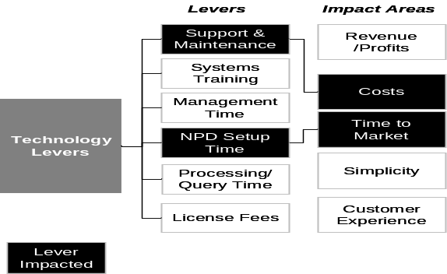

METHODOLOGY – PRODUCT PORTFOLIO OPTIMIZATION (2/2)
Focus of Rationalisation Activity
Product
Market
Technology
Tariff Subscribers
Market Segment Mix
Pragmatic
PAYG
Post paid
FMC
Fixed
Subscribers
Portfolio Mix
Volume
Kill
Cons
SME/
SOHO
Corp
Lever Assessment
Tariffs
Underweight
Full Coverage
Emerging
Product lifecycle
Alignment to Marketing Plan
Growing
Mature
Declining
Consumer Segment – Young Professionals
Revenues
Marketing Plan
Price Range

Value
Offering Mix

Criteria
Segment Fit

Range Size

Simple Elimination
Less Effort
Partial Reconfiguration
Cumulative Profit
Negative Profit
Future Market Attractiveness
Impact Analysis
Full Reconfiguration
Voice
Define Positioning
Profit
Attractiveness
Data
System Migration
Analytical
Value
Messaging
Positive outlook
Content
System Upgrade
More Effort
Tariffs
Negative outlook
Aims to identify poor performing tariffs / products / service from simple subscriber numbers through to profit contribution
Focuses on the changes that are required to existing portfolio to better align tariffs with consumer needs
Aims to establish the implications of rationalisation on the cost of managing and maintaining IT
Approach→

Slide 18

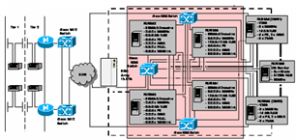
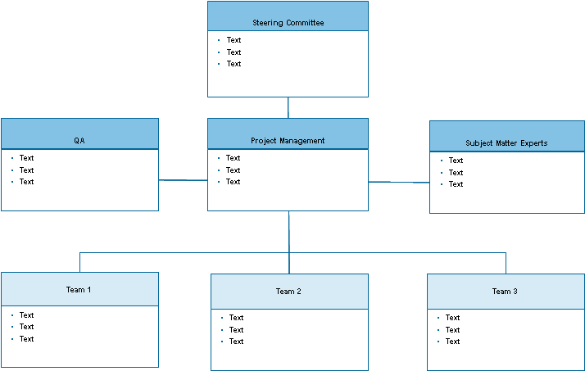
METHODOLOGY – OPERATING MODEL TRANSFORMATION
Assess AS-IS operating model
Define Operating Model “Change Criteria”
Based on Change Criteria, arrive at High, Medium, Low Scale of change
1
2
3
Assessment of the current operating model based on these criteria
Indicate a High, Medium or Low degree of impacts to the organization
Identify other influencing factors, which may be outside the scope of this program that are important
Templatized way to address this assessment
Process
Degree
of Business &
Operating
Change
% Automation
Time & Material
Impacts (FTEs)
Future
Key Performance
Indicators (KPIs)
Systems
Analyze the ‘People’ aspect based on how the above parameters change on the processes
This is a way to quantify the amount of changes that will be introduced in the organization
Organisation
The key equation is ‘People > Process > Technology’. In TO-BE, we change ‘Process’ in this equation, so what’s the impact to ‘People’?
Approach→

Slide 19
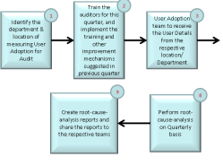
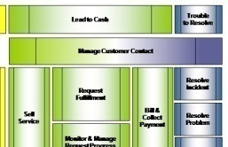
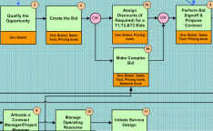
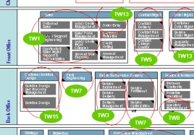
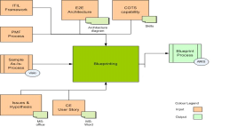
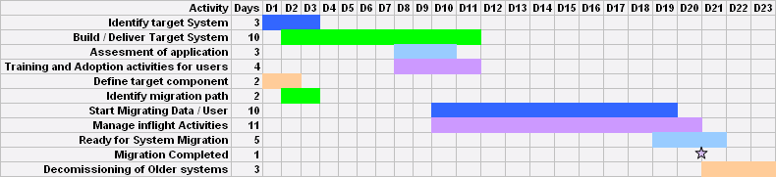
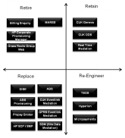
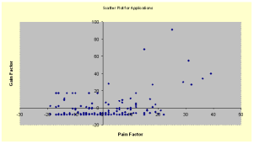
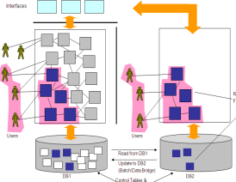
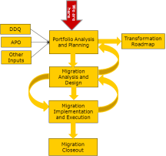
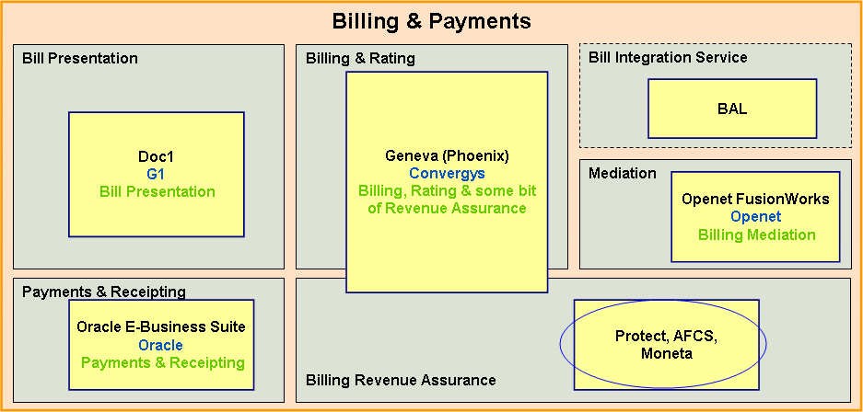
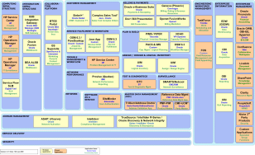
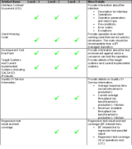
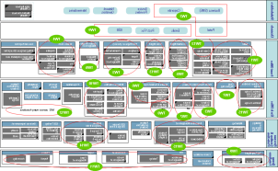
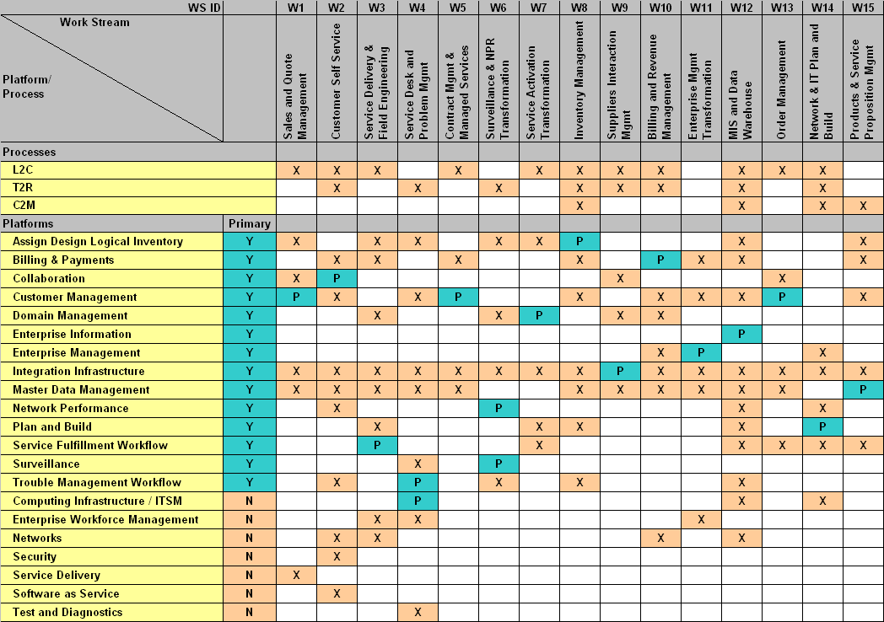
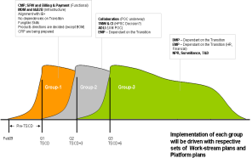
ACCELERATOR Toolkit FOR PROPOSED APPROACH
Discovery &
Scoping
AS-IS Process
Analysis
Issue-Hypothesis
Heat maps
Process
Definition &
Blueprinting
User-stories
Decomposition
Measurement, User Adoption Frameworks
AS IS Product Catalog
Assessment
AS-IS System
Analysis &
Validation
Application Criticality
vs Technology Maturity
Pain-Gain Analysis
Product Selection
Migration Planning
Recommendation
To-Be Process
To-Be Product Model
System
Blue-printing
Work-stream
& Transformation
Roadmap
Deliver TO-BE
User Stories,
Architecture
Compliance plans
Streams Definitions
Approach→

Slide 20
About Capgemini
Capgemini is a global leader in partnering with companies to transform and manage their business by harnessing the power of technology. The Group is guided everyday by its purpose of unleashing human energy through technology for an inclusive and sustainable future. It is a responsible and diverse organization of over 360,000 team members more than 50 countries. With its strong 55-year heritage and deep industry expertise, Capgemini is trusted by its clients to address the entire breadth of their business needs, from strategy and design to operations, fueled by the fast evolving and innovative world of cloud, data, AI, connectivity, software, digital engineering and platforms. The Group reported in 2022 global revenues of €22 billion.
Get The Future You Want | www.capgemini.com

